Slide 1

AIRLINE DELAY ANALYSIS / 2015 FLIGHT DATASET
Airline delays are usually small — but a few bottlenecks drive the pain
Six million flights, one operating picture.

Slide 2
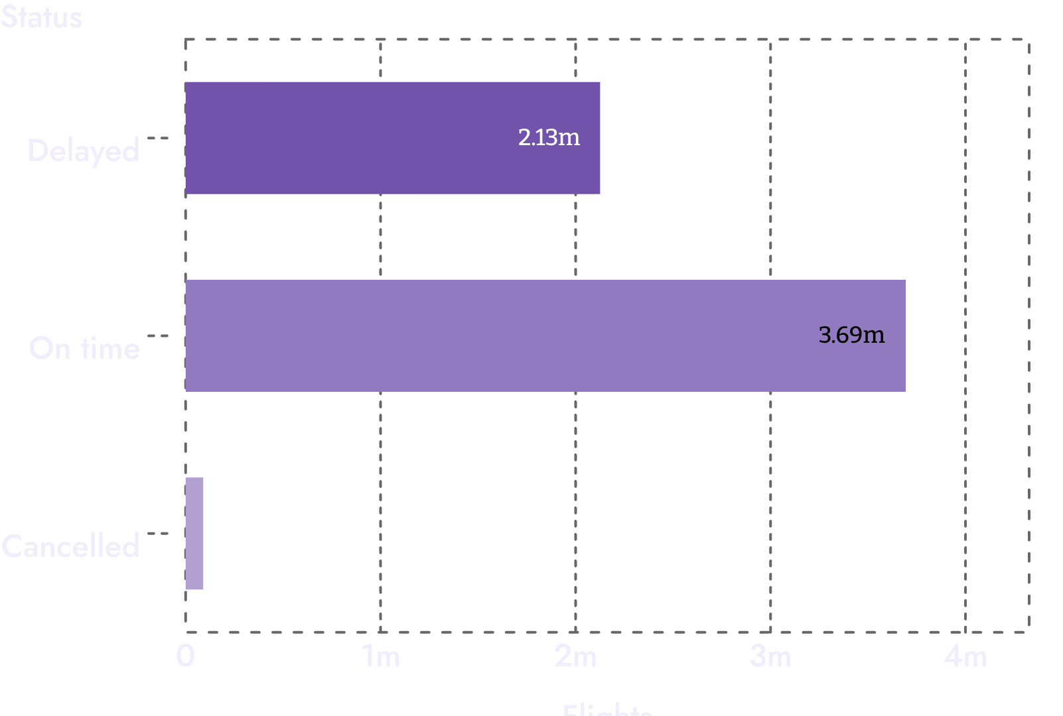
01 — SCALE OF THE PROBLEM
Six million flights reveal a 37% delay problem
DATASET
6M+ rows
30 fields · 8,606 routes analyzed across the 2015 flight dataset
DEPARTED LATE
37.08%
Of flights departed late after removing cancelled flights
CANCELLED
89,884
1.54% of the full dataset
Average departure delay: 9.4 minutes; median: −2 minutes.
2026
2

Slide 3
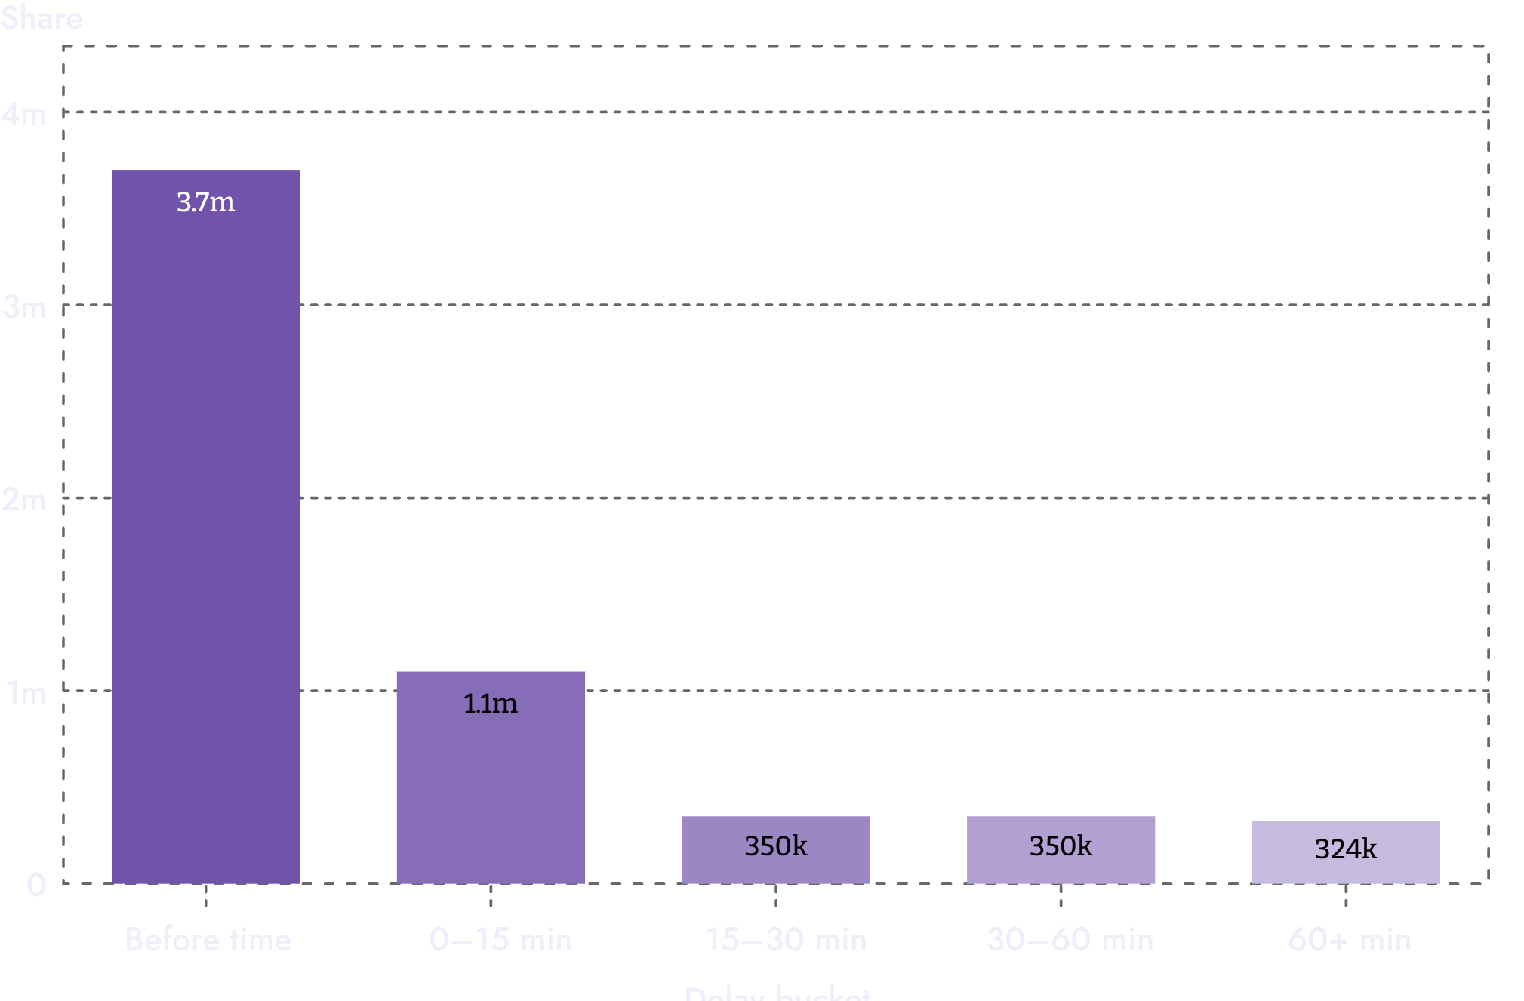
02 — DELAY DISTRIBUTION
Most delays cluster around zero — the average is pulled up by outliers
75TH PERCENTILE
7 minutes — 75% of flights had a departure delay of 7 minutes or less.
NORMAL RANGE
−10 to +10 — Most flights left between 10 minutes early and 10 minutes late.
LONG TAIL
1,988 minutes — The maximum recorded delay.
2026
3

Slide 4
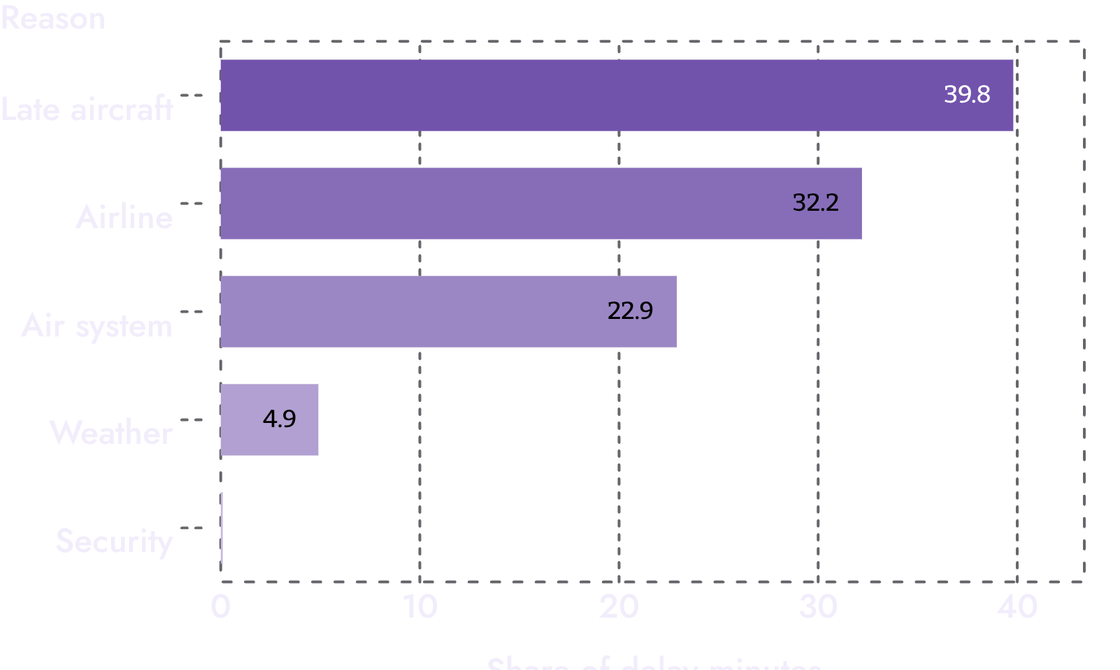
03 — DELAY REASONS
Late aircraft and airline operations explain most delay minutes
Operational causes dominate weather and security by a wide margin.
Late aircraft: 39.8% of delay minutes
Airline delay: 32.2% — the largest directly controllable share
Air system: 22.9%; weather: 4.9%; security: 0.1%
2026
4

Slide 5
04 — AIRLINE PERFORMANCE
Airline performance depends on both delay size and delay frequency
AVERAGE DELAY
Airline | Average delay (min) | Late-departure chance
Spirit | 15.94 | 44%
United | 14.44 | 50%
Frontier | 13.35 | —
Southwest | 10.58 | 45%
Alaska | 1.79 | 25%
Hawaiian | 0.49 | —
Highest: Spirit 15.94 minutes, United 14.44, Frontier 13.35. Lowest: Hawaiian 0.49 minutes and Alaska 1.79.
LATE-DEPARTURE CHANCE
United had the highest chance of a late departure at about 50%; Alaska was lowest at about 25%.
SOUTHWEST
Lower average delay than Spirit, but late more often.
2026
5

Slide 6
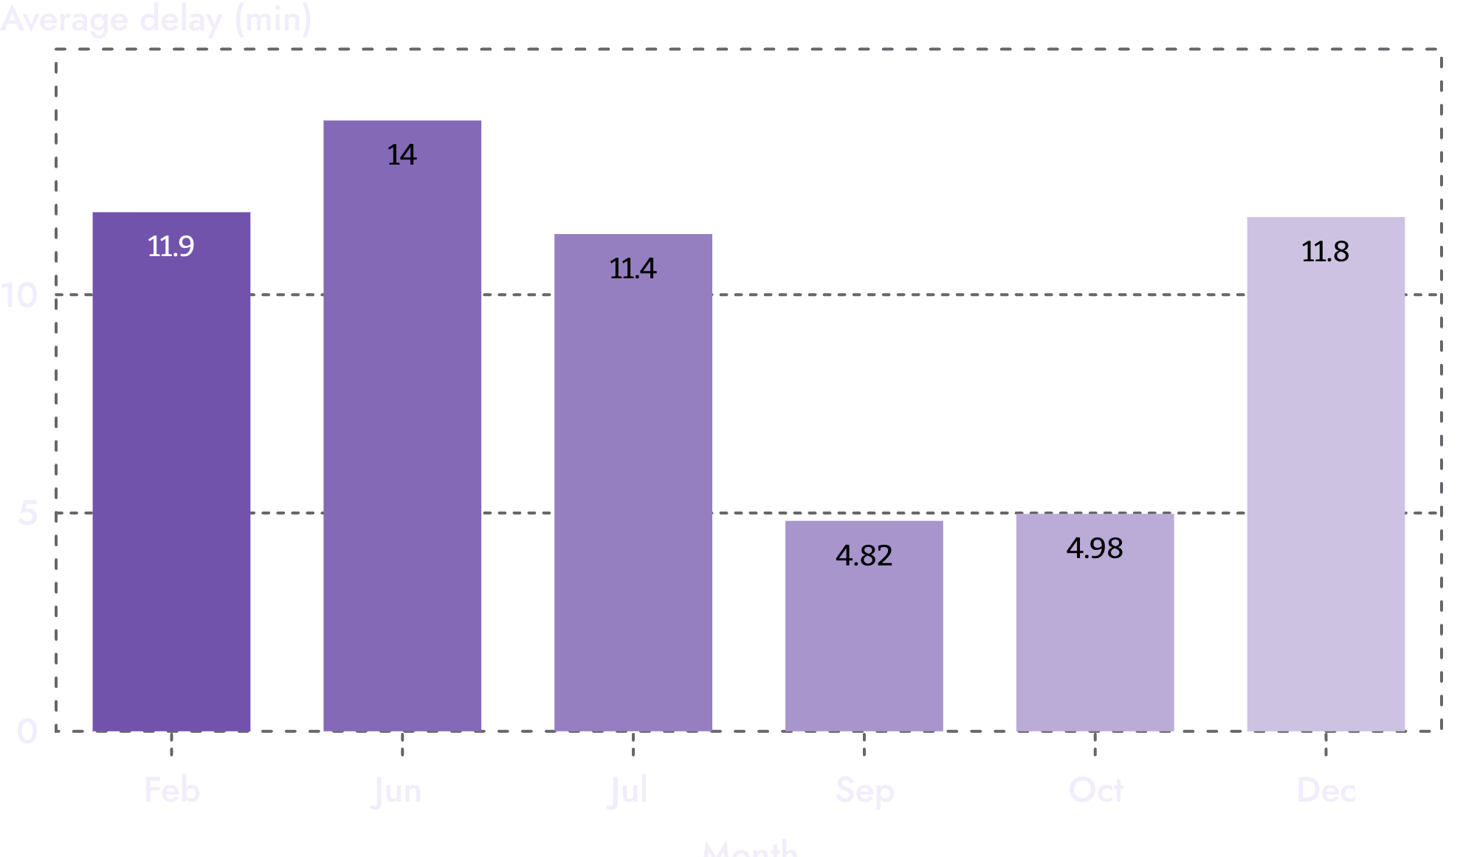
05 — SEASONAL PRESSURE
June and the winter holiday period are the seasonal pressure points
PEAK
June · 13.99 minutes
February: 11.89 · December: 11.78 · July: 11.39
LOW POINT
September · 4.82 minutes
October: 4.98 minutes
2026
6

Slide 7
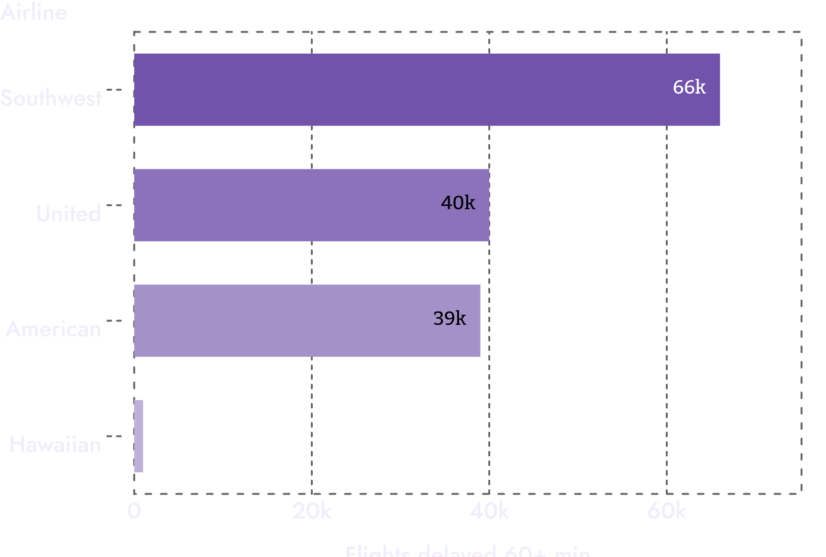
06 — SEVERE DELAYS
Severe delays are fewer — but they concentrate the passenger impact
60+ MINUTES LATE
324K flights
Around 6% of all flights.
TOP AIRPORTS
ORD · ATL · DFW
The top three airports for severe delays.
READ COUNTS WITH VOLUME
Severe delays are concentrated in high-volume operators, so counts should be read alongside fleet and flight volume.
2026
7

Slide 8
07 — ROUTE OUTLIERS
Route disruption is concentrated in a small set of outliers
WORST ROUTE
NEXT OUTLIER
OTHER OUTLIERS
IAD → TTN
SWF → PBI
RDU → IND
About 341 minutes average delay.
About 256 minutes average delay.
About 206–209 minutes for RDU to IND and SGF to HYS.
BUSIEST ROUTES
OPERATING RULE
SFO → LAX · LAX → SFO · JFK → LAX
These did not have comparably high average delay.
Route averages need a minimum-flight threshold before they become an operational priority.
2026
8

Slide 9
08 — CROSS-CHECK
Python, SQL, and Power BI converge on the same operating picture
01
02
03
Python
SQL
Power BI
37.08% delay rate after removing cancelled flights.
The same top airlines, worst months, delay reasons, and route outliers.
9.37-minute average delay and 1.5% cancellation rate.
ONE RECONCILIATION
WHY IT MATTERS
The 36.5% dashboard delay rate includes cancelled flights; Python reports 37.08% after removing them.
The cross-check makes the direction more useful than any single metric.
2026
9

Slide 10
09 — OPERATING RESPONSE
Five actions would target the largest sources of delay
Reduce late-aircraft propagation through tighter turnaround monitoring
Prioritize airline-controlled delay drivers before weather interventions
Plan extra capacity and recovery playbooks for June and winter peaks
Rank routes only after filtering for minimum flight volume
Track both average delay and probability of delay by airline
2026
10

